Slide 1
MINI ASSIGNMENT
Have y’all tried to combine both .css and .html together?
YES :D
NO ☹

Slide 2
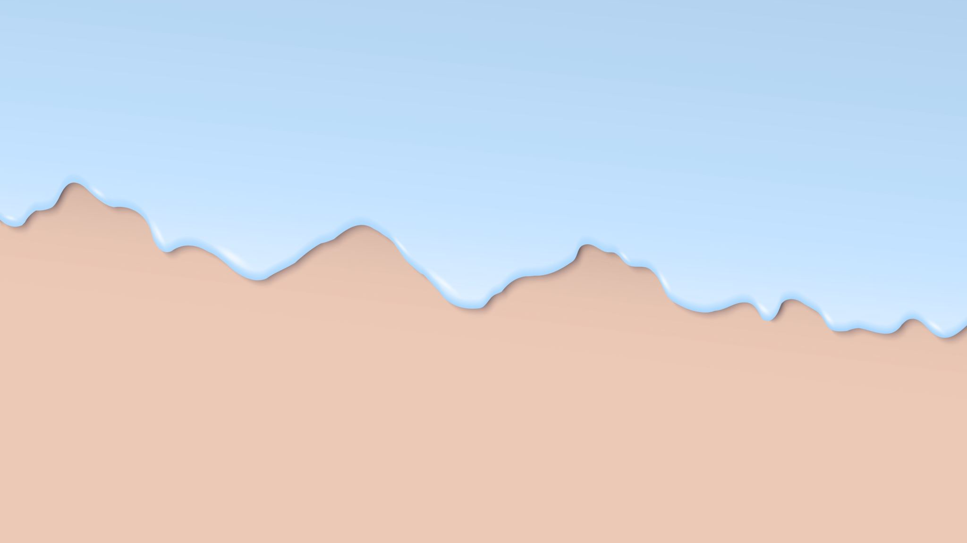
Website Layout

Slide 3
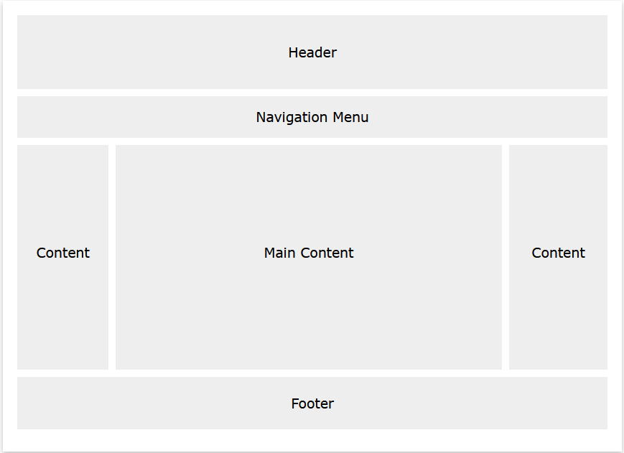
Typically…

Slide 4
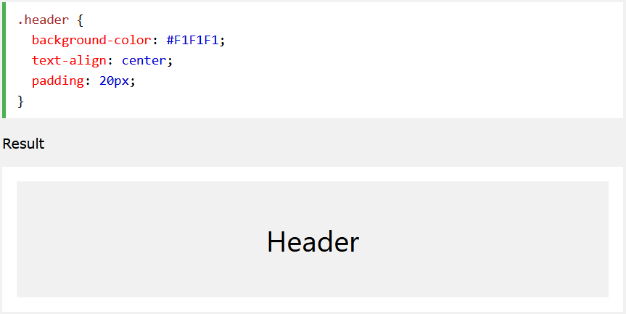
Example: Creating a header

Slide 5
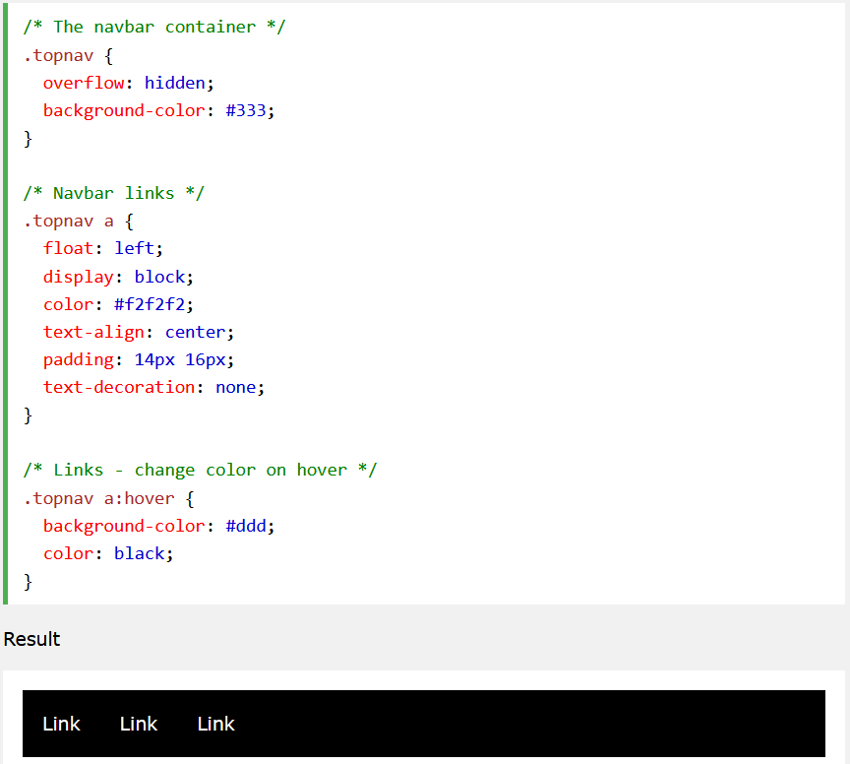
Example: Creating a Navigation Bar

Slide 6
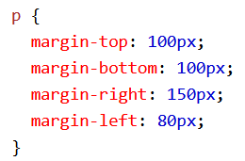

CSS Margins
Margins are used to create space around elements, outside of defined borders.
There are properties for each side of an element (top, bottom, left, right)
There is also the shorthand (shortcut) syntax:
This is for top, right, bottom, left (clockwise direction)

Slide 7
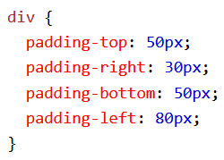

CSS Padding
Padding is used to generate space inside of its defined borders
There are properties for each side of an element (top, bottom, left, right)
There is also the shorthand (shortcut) syntax:
This is for top, right, bottom, left (clockwise direction)

Slide 8
Overall
CONTENT
Margin
CONTENT
Padding

Slide 9
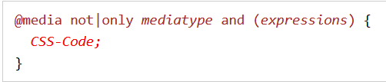
Good to know
@media rule was introduced in CSS2 to define different style rules for different media type e.g. laptop, desktop, mobile phones, etc.

Slide 10
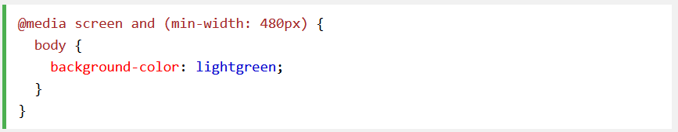
Example
Colour of background changes when the window size changes

Slide 11
Guided Example 2
Creating a standard set of layout for any typical website

